Slide 1
An Old Testament Christmas

Slide 2
Friedrich Schleiermacher
19th Century German Theologian and Philosopher
His interest in understanding the Bible led to his concern with Hermeneutics
“As every discourse has a two-part reference to the whole language and to the entire thought of its creator, so all understanding of speech consists of two elements- understanding the speech as it derives from the language and as it derives from the mind of the thinker.” 1819

Slide 3
Ferdinand de Saussure
Early 20th century Swiss Linguist
Developer of Modern Linguistics (study of the function and form of language)
“Language is a system of signs in which the only essential thing is the union of meanings and sound-images, and in which both parts of the sign are psychological.” 1916

Slide 4
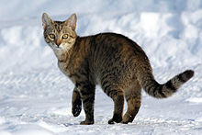
What is this?

Slide 5
Jewish Scripture
The Torah (instruction): The Penteteuch
The Tanakh: The Penteteuch, plus the prophecies, and the writings
The Talmud: The Talmud has two components; the Mishnah (Hebrew: משנה, c. 200 CE), a written compendium of Rabbinic Judaism's oral teaching; and the Gemera (c. 500 CE), an elucidation of the Mishnah and related writings that often ventures onto other subjects and expounds broadly on the Tanakh.
The entire Talmud consists of 63 tractates, and in standard print is over 6,200 pages long. It contains the teachings and opinions of thousands of rabbis (dating from before the before the Nativiety through the fifth century AD) on a variety of subjects. The Talmud is the basis for all codes of Jewish law, and is widely quoted in Rabbinic Literature.

Slide 6
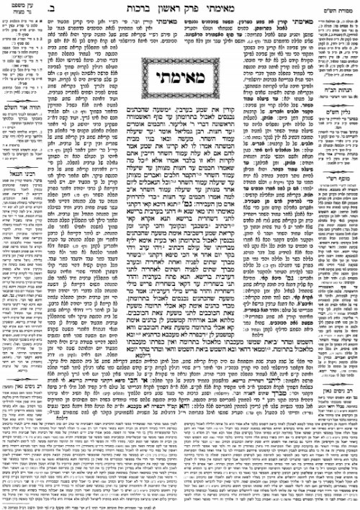
The First Page of the Talmud

Slide 7
Jewish View of the Messiah
Belief of a coming messiah (mashiach) is a basic and fundamental part of traditional Judaism. It is listed in the Mainmondes (12th Century Rabbi) 13 Principles of Faith and in the Shemoneh Esrei (a prayer recited three times daily)
The coming messiah will entail the return of all exiles to Israel, restoration of the religious courts of justice, and end of wickedness, rebuilding of Jerusalem, restoration of the line of David.
He will be fully human
Come at the ’End of Days,’ or the Messianic Age

Slide 8
And thou shalt come up against my people of Israel, as a cloud to cover the land; it shall be in the latter days, and I will bring thee against my land, that the heathen may know me, when I shall be sanctified in thee, O Gog, before their eyes. Ez. 38:16
For the children of Israel shall abide many days without a king, and without a prince, and without a sacrifice, and without an image, and without an ephod, and without image, a standing, or, statue, or, pillar. Afterward shall the children of Israel return, and seek the Lord their God, and David their king; and shall fear the Lord and his goodness in the latter days. Hosea 3:4-5

Slide 9
And there shall come forth a rod out of the stem of Jesse, and a Branch shall grow out of his roots: And the spirit of the Lord shall rest upon him, the spirit of wisdom and understanding, the spirit of counsel and might, the spirit of knowledge and of the fear of the Lord; And shall make him of quick understanding in the fear of the Lord: and he shall not judge after the sight of his eyes, neither reprove after the hearing of his ears But with righteousness shall he judge the poor, and reprove with equity for the meek of the earth: and he shall smite the earth with the rod of his mouth, and with the breath of his lips shall he slay the wicked. Isaiah 11:1-4

Slide 10
If a king from the House of David studies Torah, busies himself with the commandments like David did, observes the laws of the written and the oral law, convinces Israel to walk in the way of the Torah and to repair its breaches and fights the battles of the Lord, it may be assumed that he is the Messiah. If he succeeds at these things, rebuilds the Temple on its site, and gathers the dispersed of Israel, he is beyond all doubt the Messiah… But if he does not succeed fully, or is slain, it is obvious that he is not the Messiah promised in the Torah. Maimondes, Laws of Kings 11:3-4

Slide 11
OT Leads Us To Jesus
The Messiah will come from the tribe of Judah
Judah, your brothers will praise you; your hand will be on the neck of your enemies; your father’s sons will bow down to you. You are a lion’s cub, Judah; you return from the prey, my son. Like a lion he crouches and lies down, like a lioness—who dares to rouse him? The scepter will not depart from Judah, nor the ruler’s staff from between his feet, Or from his descendants until he to whom it belongs, Or to whom tribute belongs; the meaning of the Hebrew for this phrase is uncertain. shall come and the obedience of the nations shall be his. Genesis 49:8-10

Slide 12
Judah?
Sexually Promiscuous. Gen. 38
Was his idea to sell Joseph to the Slave Traders. Gen. 37
But
Personally guarantees Benjamin’s safety Gen. 43
Confesses and Repents to Joseph Gen. 44

Slide 13
For the priest we are talking about belongs to a different tribe, whose members have never served at the altar as priests. ¹⁴ What I mean is, our Lord came from the tribe of Judah, and Moses never mentioned priests coming from that tribe. Heb. 7:14
But one of the twenty-four elders said to me, “Stop weeping! Look, the Lion of the tribe of Judah, the heir to David’s throne,^{[b]} has won the victory. He is worthy to open the scroll and its seven seals.” Rev. 5:5

Slide 14
The Messiah Will Be a Descendent of David
“For the time is coming,” says the Lord, “when I will raise up a righteous descendant^{[a]} from King David’s line. He will be a King who rules with wisdom. He will do what is just and right throughout the land. ⁶ And this will be his name: ‘The Lord Is Our Righteousness.’^{[b]} In that day Judah will be saved, and Israel will live in safety. Jer. 23:5-6

Slide 15
A Hezekiah Interlude
In the third year of Hoshea son of Elah, king of Israel, Hezekiah the son of Ahaz, king of Judah, began to reign. He was twenty-five years old when he began to reign, and he reigned twenty-nine years in Jerusalem. His mother's name was Abi the daughter of Zechariah. And he did what was right in the eyes of the Lord, according to all that David his father had done. He removed the high places and broke the pillars and cut down the Asherah. And he broke in pieces the bronze serpent that Moses had made, for until those days the people of Israel had made offerings to it (it was called Nehushtan). He trusted in the Lord, the God of Israel, so that there was none like him among all the kings of Judah after him, nor among those who were before him. For he held fast to the Lord. He did not depart from following him, but kept the commandments that the Lord commanded Moses. And the Lord was with him; wherever he went out, he prospered. He rebelled against the king of Assyria and would not serve him. He struck down the Philistines as far as Gaza and its territory, from watchtower to fortified city. 2 Kings 1:1-8

Slide 16
For to us a child is born, to us a son is given; and the government shall be upon^{[d]} his shoulder, and his name shall be called Wonderful Counselor, Mighty God, Everlasting Father, Prince of Peace. Of the increase of his government and of peace there will be no end, on the throne of David and over his kingdom, to establish it and to uphold it with justice and with righteousness from this time forth and forevermore. The zeal of the Lord of hosts will do this. Isaiah 9:6-7
The mighty God (’êl Gibbôr) either “God-like Hero” or Hero-God.

Slide 17
The talmud recognizes this passage of scripture as being a messianic passage. There is a specific conversation where the question is raised if Hezekiah is the person intended to fulfill this prophecy. While the writers of the talmud knew the passage to point towards the messiah they also knew that Hezekiah was not him.
The passage goes on to imply that Hezekiah was not the Messiah, and it explains that the closed mem signifies that the decision concerning the Messiah was closed for now and postponed to another time.

Slide 18
The Messiah Will Be Born of A Virgin
Therefore the Lord himself will give you a sign. Behold, the virgin shall conceive and bear a son, and shall call his name Immanuel. Is. 7:14

Slide 19
Again the Lord spoke to Ahaz: “Ask a sign of the Lord your^{[f]} God; let it be deep as Sheol or high as heaven.” But Ahaz said, “I will not ask, and I will not put the Lord to the test.” And he said, “Hear then, O house of David! Is it too little for you to weary men, that you weary my God also? Therefore the Lord himself will give you a sign. Behold, the virgin (almah) shall conceive and bear a son, and shall call his name Immanuel. Is. 7: 11-14.
Almah: young girl, maiden, girl of marriage age, virgin

Slide 20
The Messiah Will Be Visited By Distant Kings Who Would Bow Down and Bear Gifts
May the kings of Tarshish and of distant shores bring tribute to him. May the kings of Sheba and Sebapresent him gifts. May all kings bow down to him and all nations serve him. Psalm 72:10-11
Can be read as concerning Solomon, but Solomon does not meet all of the qualifications of the remainder of Psalm 72.

